Slide 1
CS300A Technical Communications Progress Report, Completion Report and Manuals
Acknowledgement: Some slides prepared by
Nitin Saxena
Rajat Mittal

Slide 2
Progress Report
Directly related to the Project Proposal and earlier Progress Reports (if any).
Project was sanctioned on the basis of outline of work to be done in the proposal (including deliverables and time-lines).
You have to explain for each module, what was expected and what has been done so far.
You also have to explain the reasons for the delays (if any) and how do you plan to make up for it.
Progress report may also include the details of human resources hired and trained.
Also include the details of equipment acquired and the total expenses.
May also request for transferring part of the budget from one head to another with justification.
May also try to request for extension (generally without any additional funds)
A bad Progress Report may lead to the termination of project and sometimes (very rarely) returning of the money received so far (used/unused).
web.cse.iitk.ac.in/~cs300/ProgressReport.pdf

Slide 3
Completion Report
Submitted after the project has been completed.
Needs the details of all objectives mentioned of the proposal and their status.
Complete Technical Details of the Project.
Manpower Details.
Financial Details.
Manuals:
Technical Manual
Developer Manual
Installation Manual
User Manual
http://web.cse.iitk.ac.in/~cs300/CompletionReport.pdf

Slide 4
Installation Manual
Gives the detailed procedure of installing the product (software/hardware).
Start from the starting
Assembling instructions in case of Hardware
Have to be very careful in writing the installation manual. Missing even a single small instruction may make the product useless. You may even have to write that put the plug in the electric socket (which seems intuitive/obvious).

Slide 5
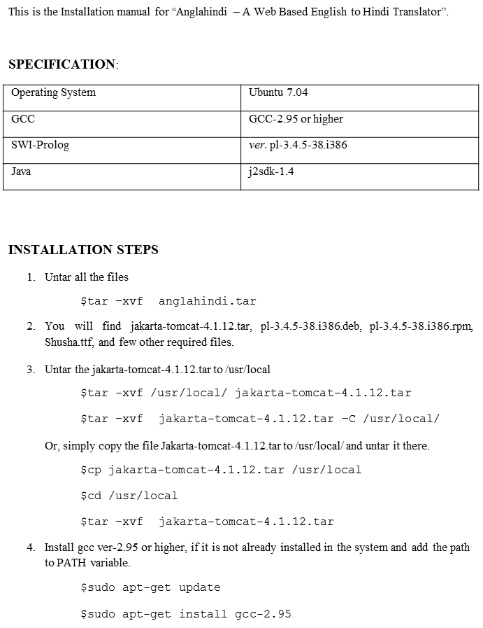
[ANGLAHINDI] IIT KANPUR
A web-based English to Hindi Translator based on Anglabharati Technology
INSTALLATION MAUAL

Slide 6
Install SWI-Prolog.
$dpkg –i pl-3.4.5-38.i386.deb
If there is any problem in installing form the deb file (say the deb file gets corrupted), you can use the rpm file to create the deb file. The rpm file is available online.
$sudo apt-get install alien
$sudo alien -k pl-3.4.5-38.i386.rpm
$dpkg –i pl-3.4.5-38.i386.deb
Then link the following in lib directory.
$cd /lib
$sudo ln –s libreadline.so.5.2 libreadline.so.4.0
Install j2sdk1.4
$sudo apt-get install j2sdk1.4
Install Shusha font.
Steps for installing Shusha font:
$cd /usr/share/fonts/truetype
$mkdir ttf-hindi-fonts
$cd ttf-hindi-fonts
Copy Shusha.TTF to this folder
Rebuild the font cache:
$ sudo fc-cache -f -v
Now, the system is ready to use as a server for the Web Based English to Hindi Translator, ANGLAHINDI.
STARTING & STOPPING THE SERVER
To start the jakarta-tomcat server, first move to the bin of the Jakarta installation.
$cd /usr/local/jakarta-tomcat-4.1.12/bin
Then run the shell file named start_vic.sh
$sh ./start_aj.sh
Now, you can access the service by typing the following address in the address-bar of the browser:
http://system-ip-address:8080/anglahindi/index.html
To stop the server, run the file named shutdown_vic.sh
$sh ./shutdown_aj.sh

Slide 7
User Manual
Make sure to use the product, understand it and then write about it.
User-test the product and the manual with real users.
Consider the needs of disabled users and provide an alternative manual.
Braille, large print, audio, etc.
Use color effectively.
Pictures, diagrams, etc.
Organize information hierarchically.
Avoid lengthy paragraphs.
Use everyday words, not jargon.
http://tdil-dc.in/mt/common.php#

Slide 8
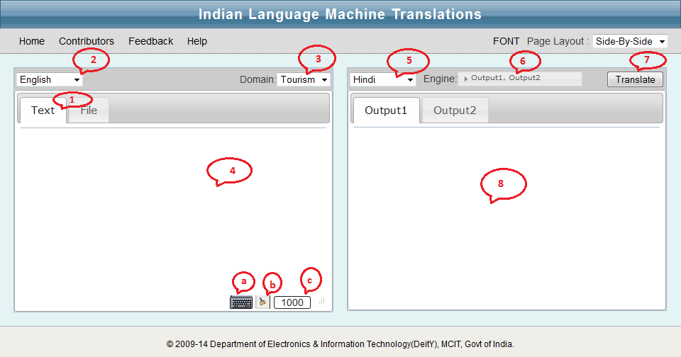

Slide 9
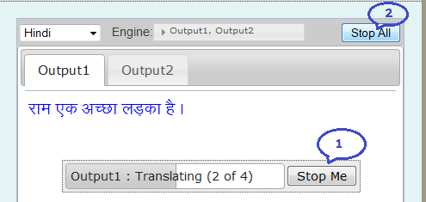

Slide 10
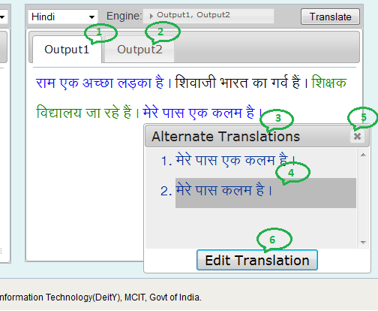
Clicking on causes"Alternate popup (3), from translation (4)can
any
translation
Translations" to
which alternative
be choosen to be
placed into the output pane. To cancel
the popup click
button (5).
on the "x" (close)
10. Even if any alternative translation is not suitable, user can write translation of their own by clicking on the "Edit Translation" button (6).
Now "Edit Translation" popup (1) window will appear which can be used to write own translation or edit current translation. In this popup "Input Sentence" (2) is a read only text pane displaying the corresponding input sentence and "Manual Translation" text pane (3) is to type the corrected translation by physical keyboard / soft keyboard. To get the soft keyboard user can click on the keyboard icon (4) at the right of the "Manual Translation:" label. After writing of, if user wants it to be final, click on the "Ok" button (8), otherwise, click on the "x" (close) button (9)

Slide 11
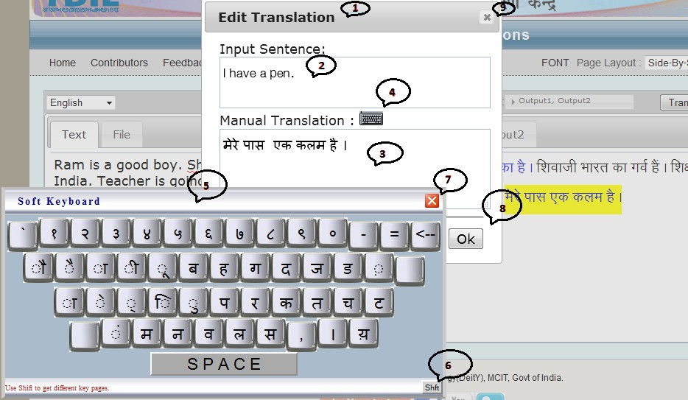
11. The final output can be used (by copy paste from output pane) to compose any other document. For next batch of translation user may clear the input and output pane by clicking "clear" button (b) at the bottom of input pane.
Soft Keyboard

Slide 12
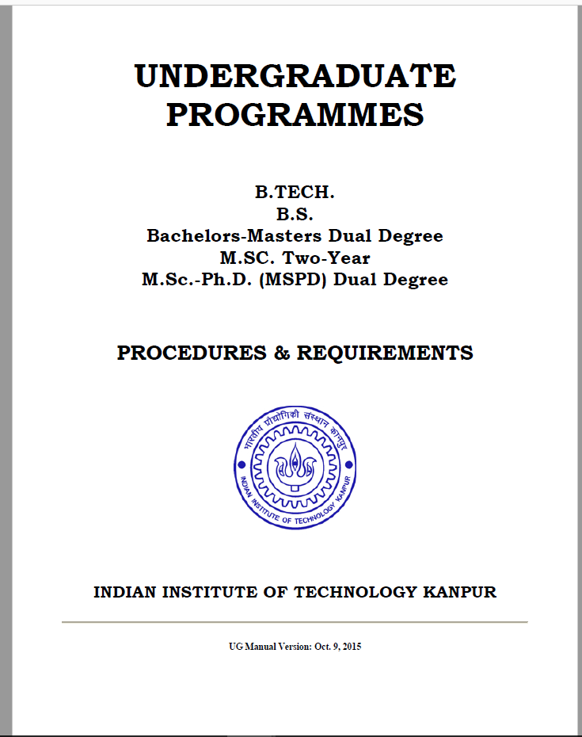
What is a Manual?
`` … is a technical/non-technical communication document
intended to give assistance
to people using a particular
system.’’

Slide 13
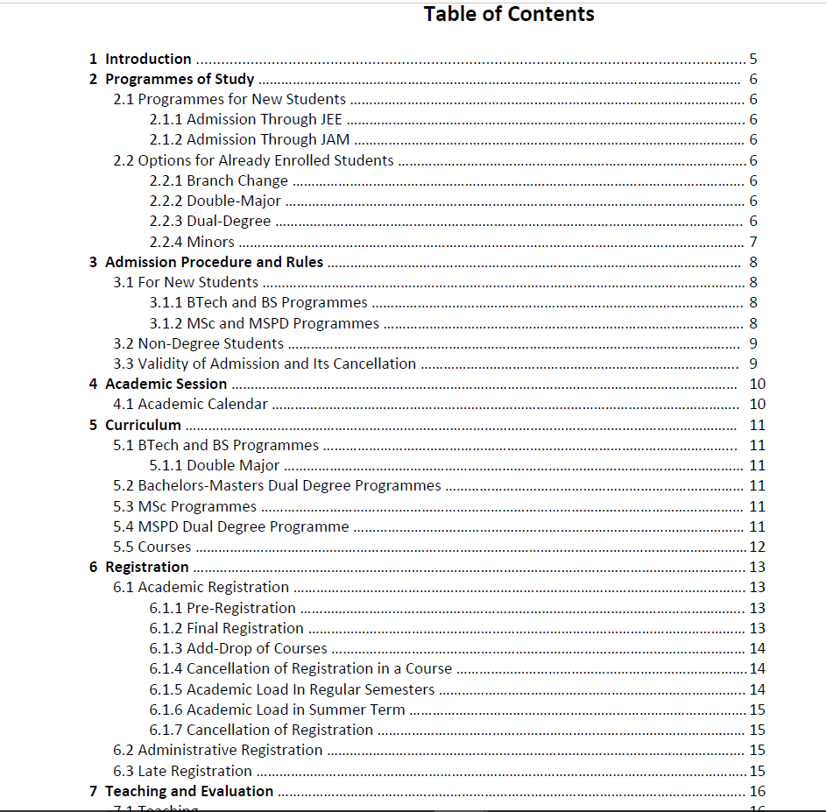
Manual book example

Slide 14
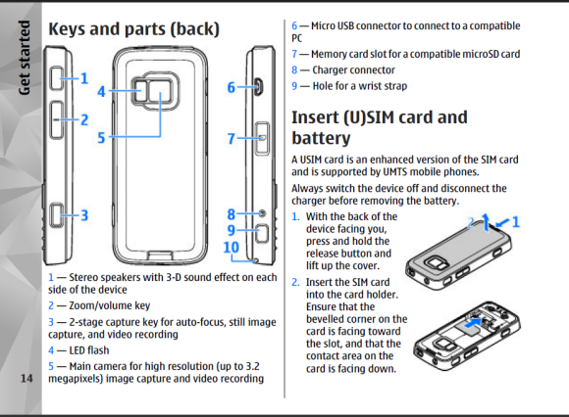
Purpose
To describe a process step-by-step.
Provide visual stepping stones.
Provide a one-page quick
start guide.

Slide 15
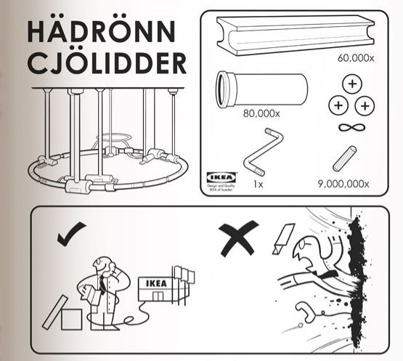
Contacts
Clearly display the help-line number, email, Facebook link etc.

Slide 16
Developers’ Manual
Mainly an internal document prepared by the employees working on the project.
To be used by the same team or another team for further development/improvement of the product (or similar products).
Consists of all decisions taken by the team at time to time and their justifications (pros and cons of various approaches/alternatives).
Sometimes it may consist of intermediate test results (not necessarily to be shared with public and monitoring agencies.
Most of the time, it is a confidential document.
(A good read: Bottle of Lies: Katherine Eban).

Slide 17
Technical Manual
For helping other team members who may continue with the project for further refinements.
Also needed for Technology Transfers so that the transferee can understand and modify the product as per requirement (subject to the conditions of technology transfer)
Not as comprehensive as Developers manual. Doesn’t contain confidential information.
For software projects, it is mainly define the working of each programming module, its inputs and outputs, data structure etc.
https://web.cse.iitk.ac.in/users/cs300/TechnicalManual.pdf

